Slide 1
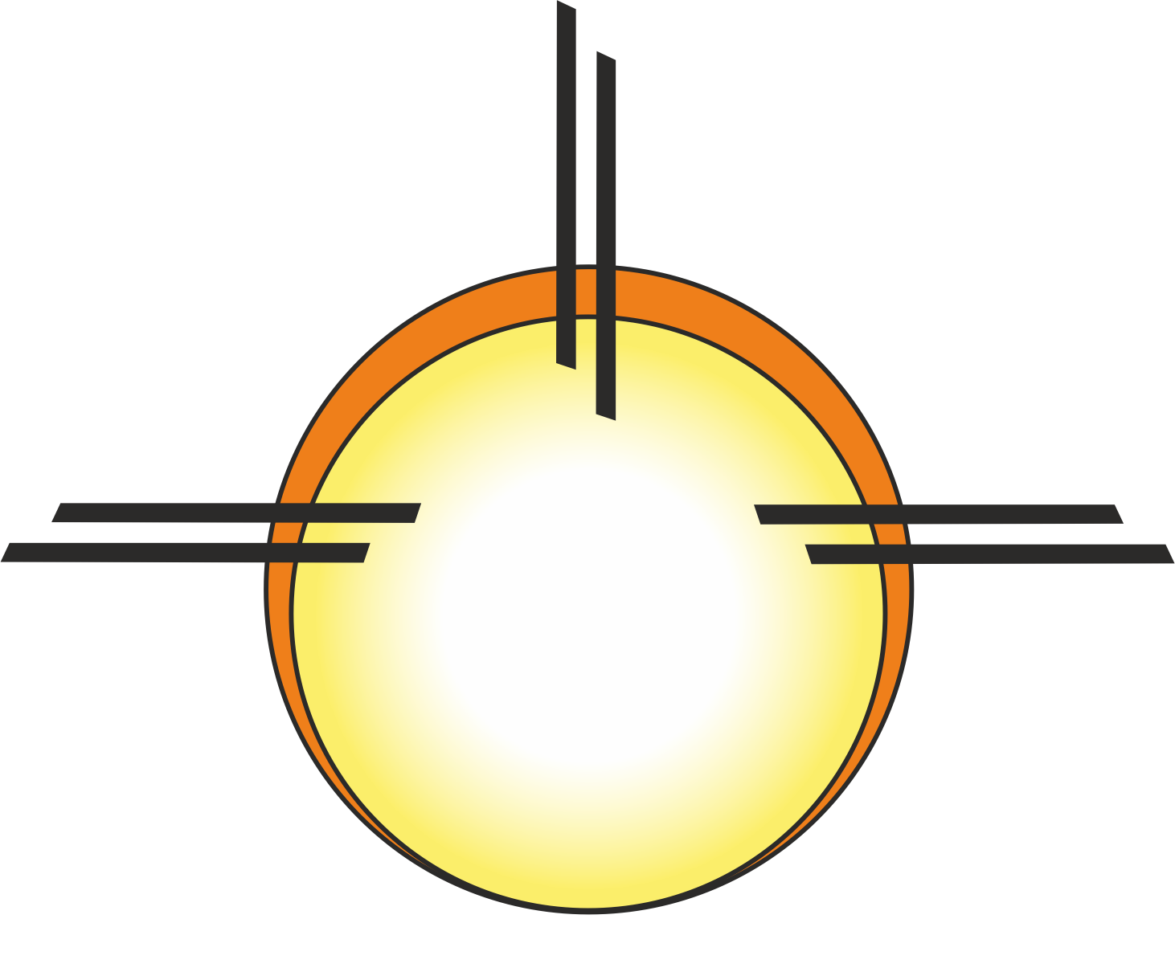
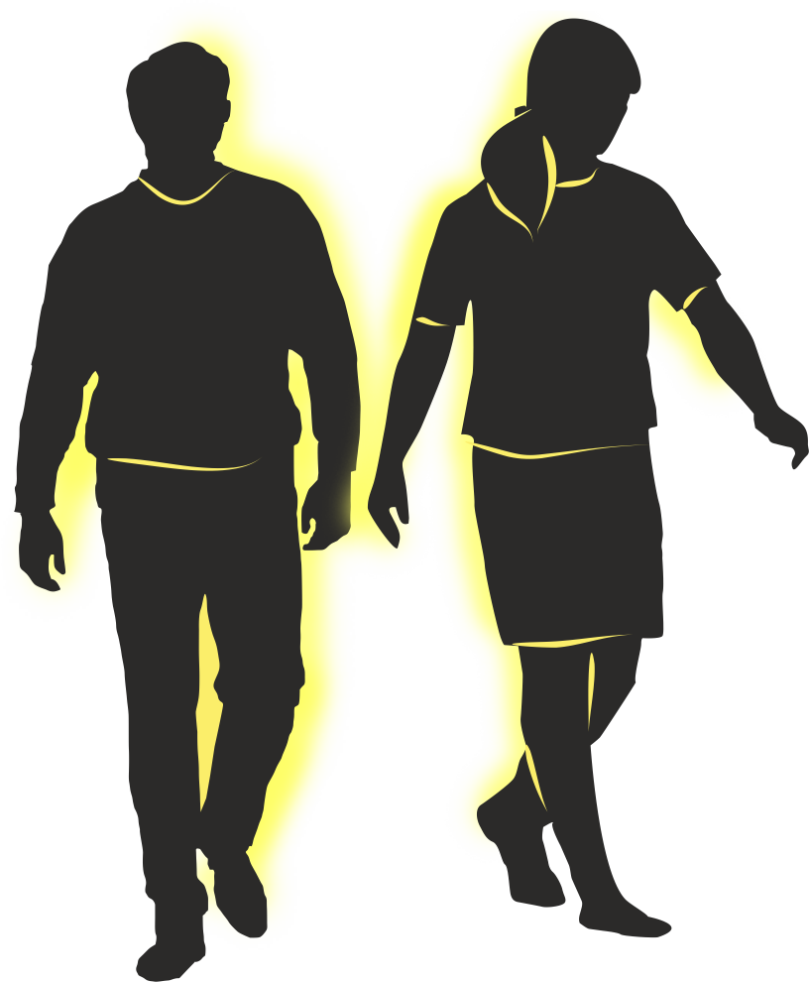
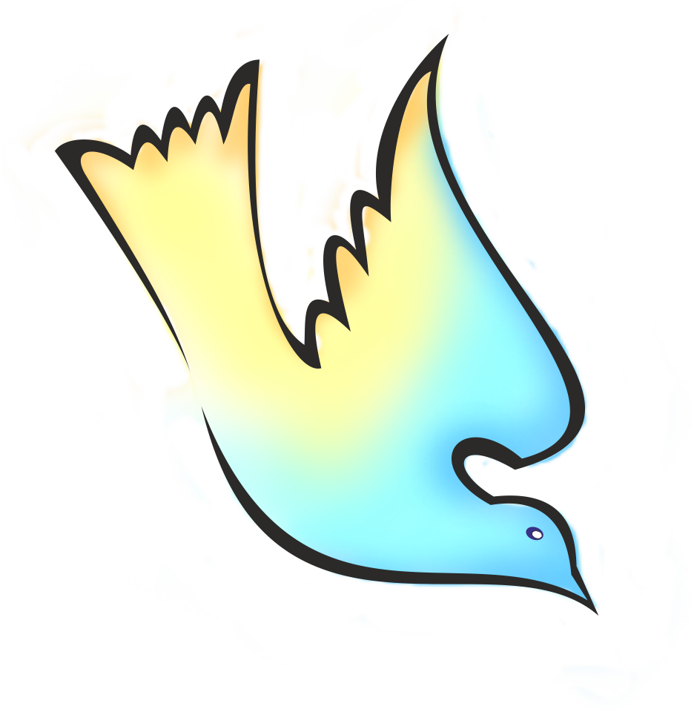
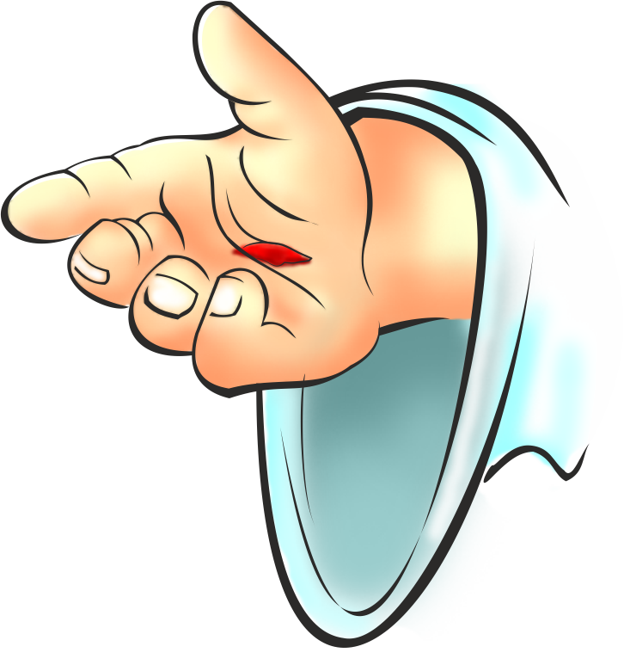
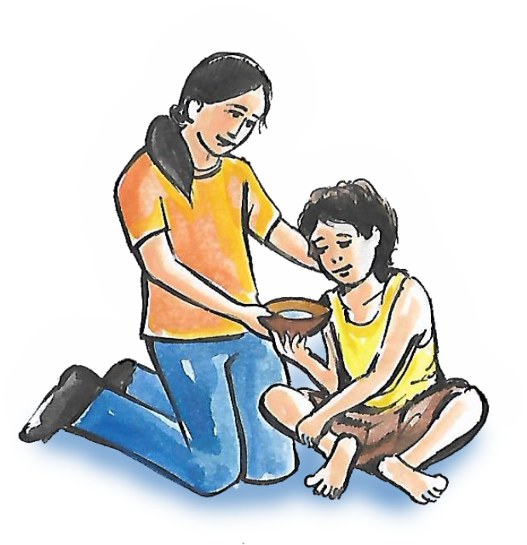
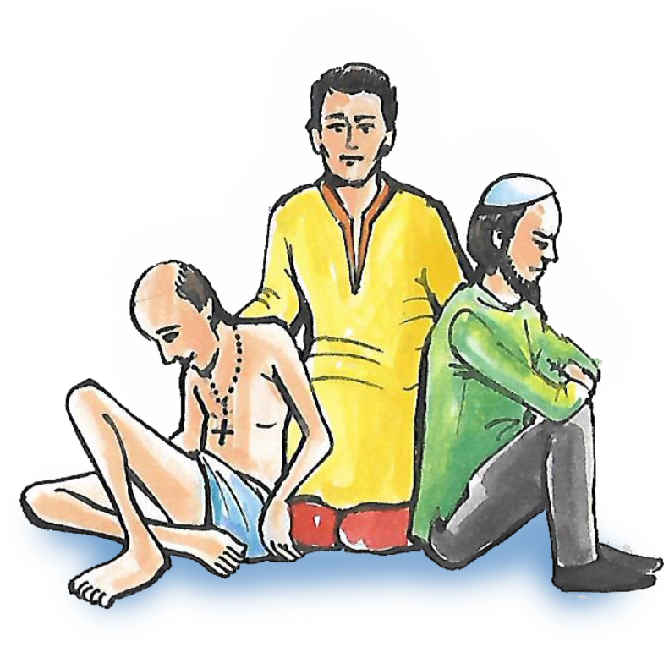
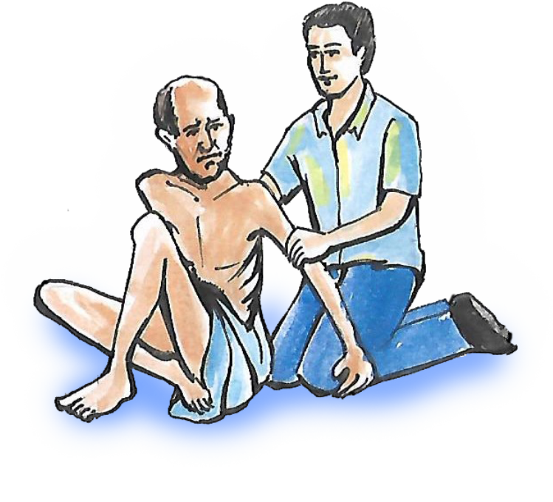
1. Uzvaddacho atto: Dev-Bapacho. To mon'xak sfurti dita, mon’ xakullacho mog ani chakri korunk.
3. Parvo: Dev-Povitr Atmeak khunnaita. Devacho Povitr atmo zo amkam aplea denneamni ani follamni aplem misanv fuddem vhorunk bhorta.
2. Vistarlolo hat: Dev-Putacho, Jezucho hat. To amkam amontronn dita dusreank adar diunk ani amchi girestkai dublleam sovem ani gorjevontam sovem vanttunk.
5. Ami (Kalli Savlli) vinchun kaddlam bhor ghalunk ani gorjevontank, ghaiall zal' leank,
poro ghal' leank ani osoktank, vorg, dhorm, zat- Kat vo kul polle nastanam soglleanchea adarak pavunk.
4. Kirnnam: Amkam Jezu Kristache porjek tachi adnia fuddem vhorunk amkam patthoileant: ‘Voch ani tum-vui toxench kor’.

